Slide 1
Capstone Project 1 Play Store App Review Analysis -Turab Ahmed

Slide 2
Topics for discussions:
Data Summary
App Installation statistics
Exploring the Categories
Free VS Paid Apps
Exploring Ratings
Five star rated apps
Exploring Android versions and Genres
Sentimental Analysis
Positive, Negative and Neutral reviews
Conclusion

Slide 3
Data Summary
ps_data_df: It contains all the information about the play store apps, reviews, Category, Number of installations, Price and many more information
Family_category: It contains the apps which belongs to family category
Gaming_category: It contains apps which belongs to game category
Paid_df: It contains data frame of PAID apps
Free_app_df:It contains data frame of FREE apps
user_review_df: It contains all the information regarding the sentiments, Translated reviews and many other information

Slide 4
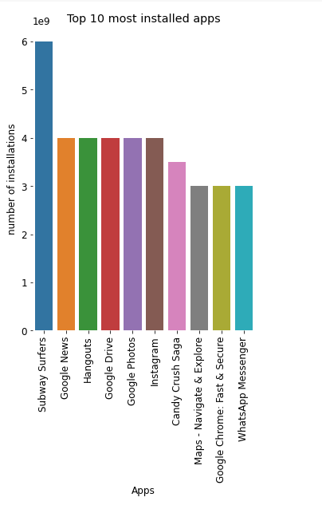
App Installation statistics
“Subway Surfers” is most installed app in Playstore with 6 billion+ installations and it alone accounts for 3.58% of installations.
“Google News”,” Hangouts “,” Google Drive”,” Google Photos” and ” Instagram are installed for 4 Billion + times which accounts for 2.39% of installations alone for each app
“Candy Crush Saga” is the third most installed app with 3.5 Billion+ installation and it accounts for 2.09% installations
“Maps - Navigate & Explore”, ”Google Drive”,” Google Chrome”,” WhatsApp Messenger” is installed 3 Billion + times and each app accounts for 1.80% of installations

Slide 5
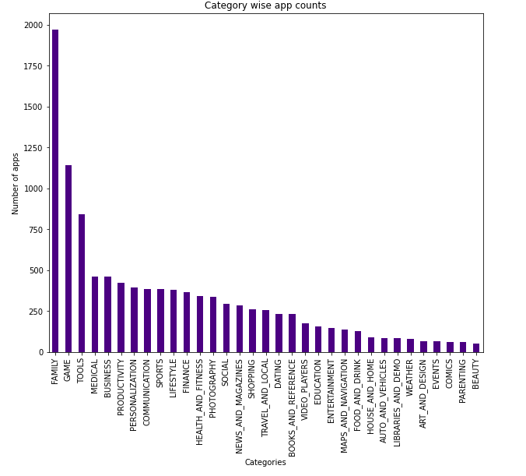
Exploring Categories
The category “FAMILY” has the greatest number of apps which is about 1900+ apps.
“GAME” holds the second the greatest number of apps which has 1200+ apps.
“TOOLS” category holds third most number of apps which has 800+ apps.
“MEDICAL” and “BUSINESS” category comes in fourth place which has 400+ apps
“PRODUCTIVITY” category comes in fifth place with 375+ apps in play store

Slide 6
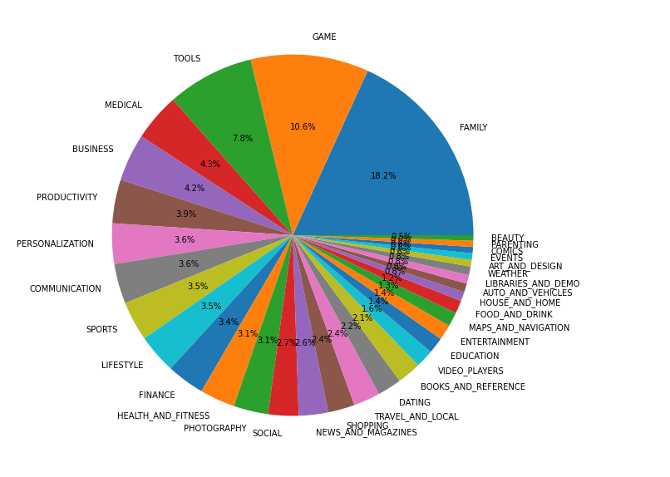
Exploring All category wise apps in percentile
“FAMILY” category alone accounts for 18.02 % of apps
“GAME” category accounts for 10.6% of apps
“ TOOLS” category accounts for 7.8% of apps
“MEDICAL” category accounts for 4.3% of apps
“BUSINESS” category accounts for 4.2% of apps

Slide 7
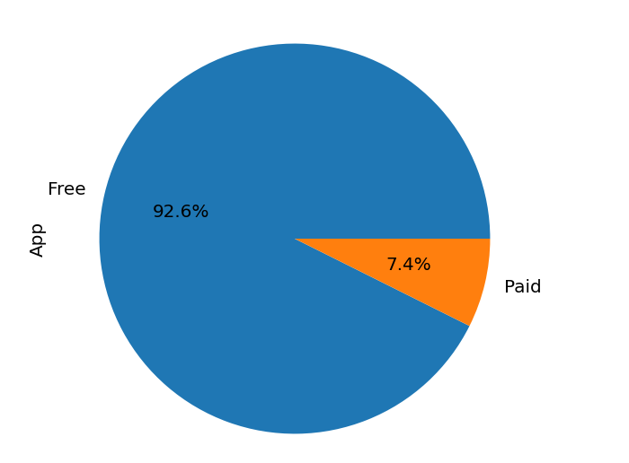
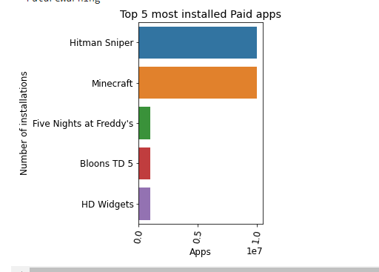
Paid VS Free Apps
FREE app accounts for 92.6 % of apps while PAID apps accounts for only 7.4% of apps.
In Google Play store, we have total of 10039 FREE apps and 800 PAID apps available.
The costliest Paid app is “I'm Rich - Trump Edition” with a cost of $400.0 and the app has total installations of 10000+
The top 5 most installed PAID apps are
“Hitman sniper” with 10 Million + Installations
“Minecraft” with 10 Million + Installations
“Five nights at Freddy’s” with 1 Million + Installations
“Bloons TD 5” with 1 Million + Installations and
“HD widgets” with 1 Million + Installations

Slide 8
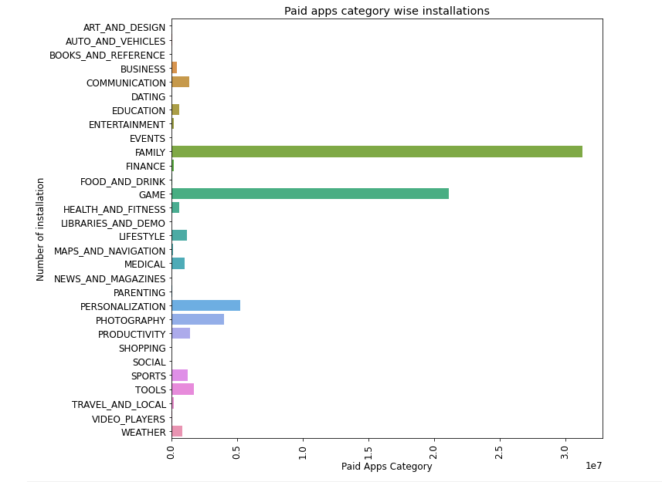
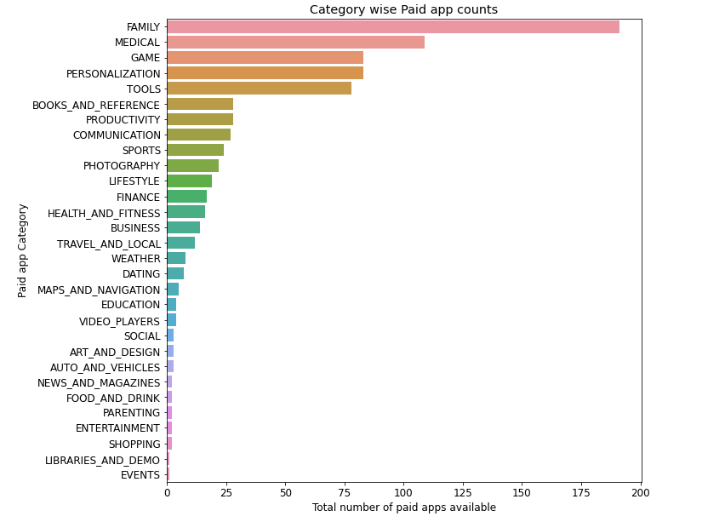
Exploring PAID apps categories
Total Paid apps installed by the users is 72 Million+ in Google play store
“FAMILY” category is the most installed paid app category with 30 Million+ installations and it has 175+ apps available
“GAME” category is second most installed paid app with 20 Million + installations and it has 110+ apps available.
“PERSONALIZATION” is the third most installed paid app category which has 5 Million+ installations and it has 80+ apps in play store
“PHOTOGRAPHY” is the fourth most installed paid app category which has 4 Million+ installations and it has 80+ apps available in play store

Slide 9
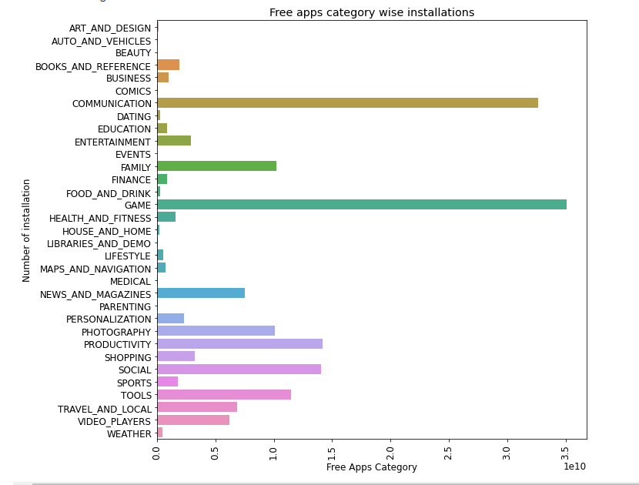
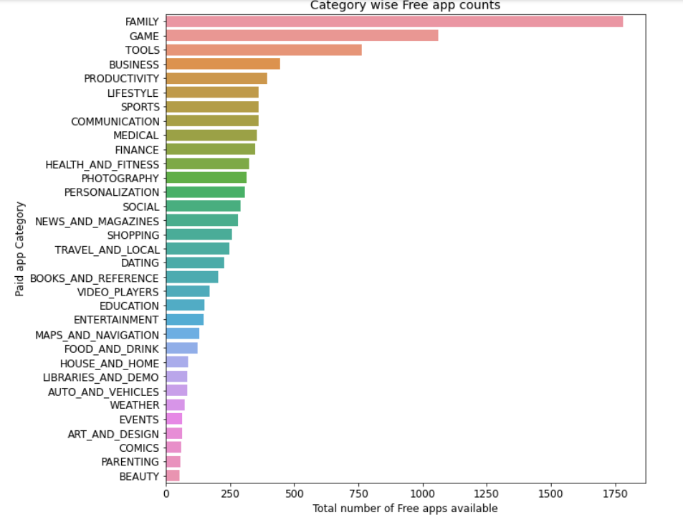
Exploring FREE app and its category
The total free apps installed in play store by the users is 167.56 Billion+ installations
“GAME” category is the most installed Free app with 35 Billion+ installations and it has 80+ apps available
“COMMUNICATION” is the second most installed Free app category with 32 Billion+ installations and it has total of 25+ apps available in play store
“PRODUCTIVITY” is the third most installed Free app category with 14 Billion+ installations and it has 25+ apps available in play store
“SOCIAL” is the fourth most installed Free app category with 13.5 Billion+ installations and it has only 3+ apps available in the Google play store

Slide 10
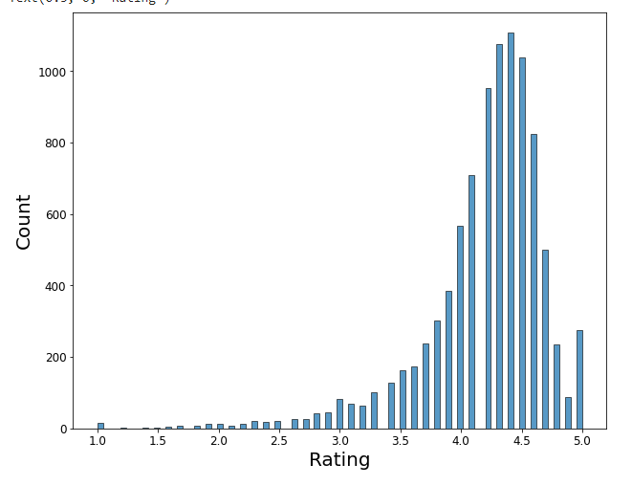
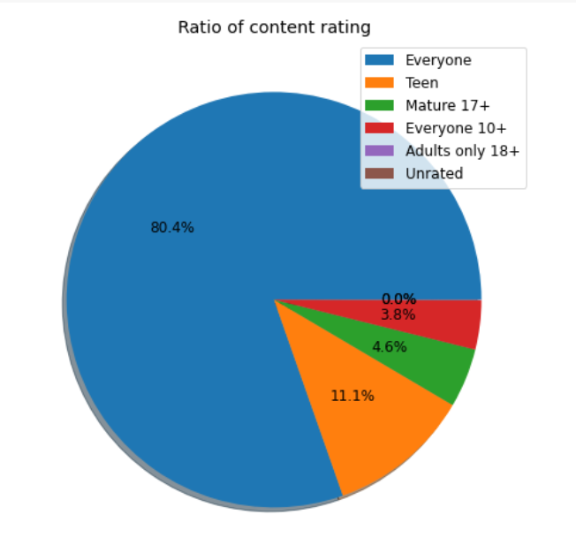
Exploring Ratings
The total reviews given by the users in Google play store altogether app combined is 4.81 Billion+ reviews
“FACEBOOK” is the most reviewed app with 78 Million+ reviews
Rating with 4.4 stars has more apps with 1100+ apps, followed by 4.3 stars with 1050+ apps and 4.5 stars with 1000+ apps
Most of the reviews is provided with content belongs to “Everyone” which accounts for 80.4%, then followed by “Teen” with 11.1%

Slide 11
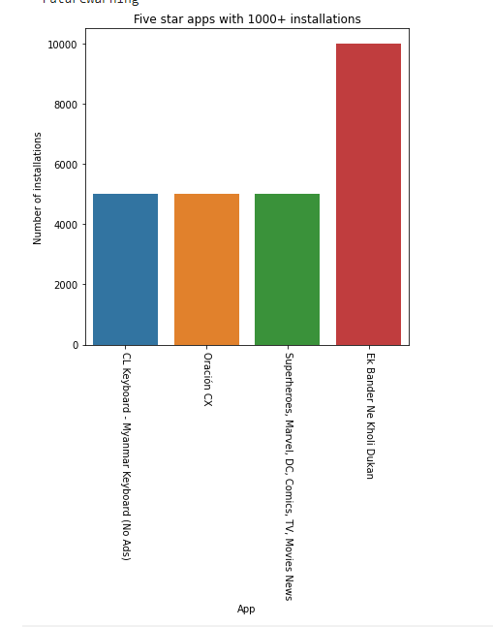
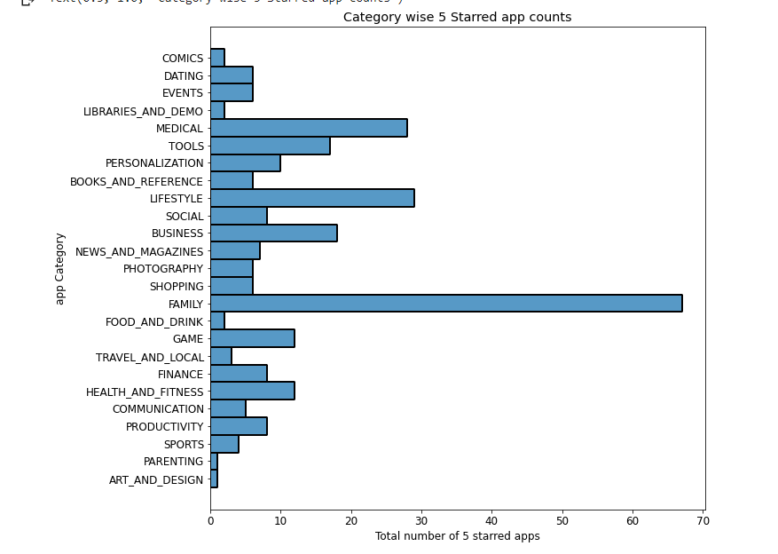
Five starred apps
The total 5 starred app in Google play store are 274 apps
“Ek Bander Ne Kholi Dukan” is the top rated app with atleast 10000 installations, followed by “Oracion CX”, “CL Keyboard” and “Superheroes, Marvel, DC, Comics”
When exploring the category, “FAMILY” category has most 5 star rated app with 67 apps, followed by “LIFESTYLE” with 30+ apps and then “MEDICAL” category with 30 apps.

Slide 12
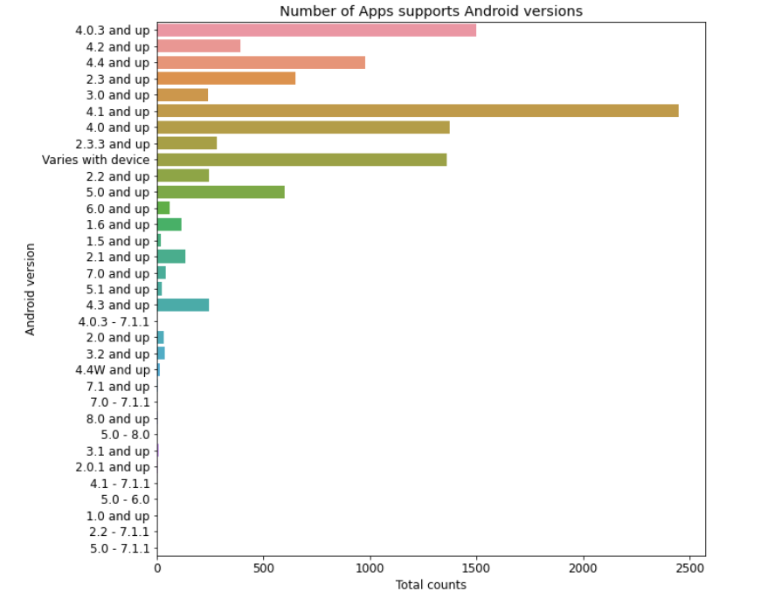
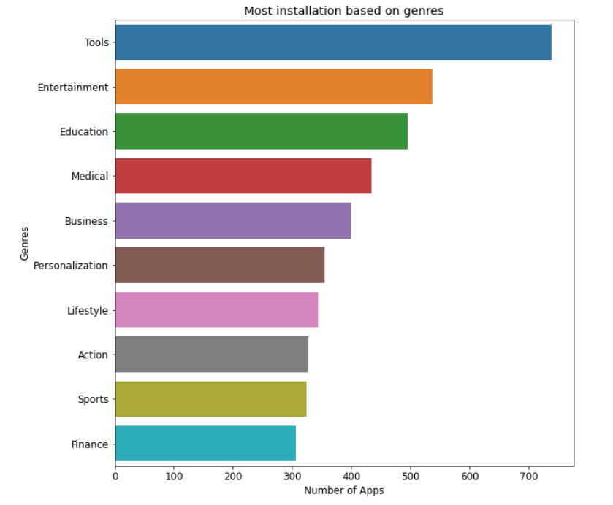
Exploring Android versions and Genres
Most of the Apps supported are by Android version 4.1 and up which has a total count of 2400+ apps.
4.0.3 android version supports 1500+ apps which marks the second in the list
When exploring the Genres, “TOOLS” is the most number of apps available in play store with 700+ apps.
“ENTERTAINMENT” and “EDUCATION” genres comes in second and third in the list with 500+ apps.

Slide 13
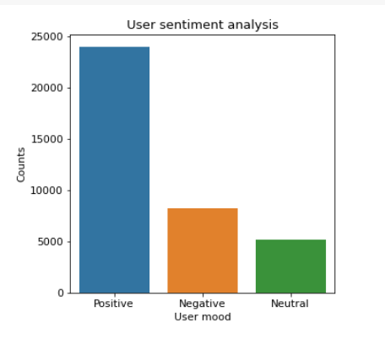
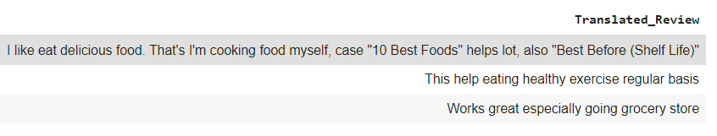
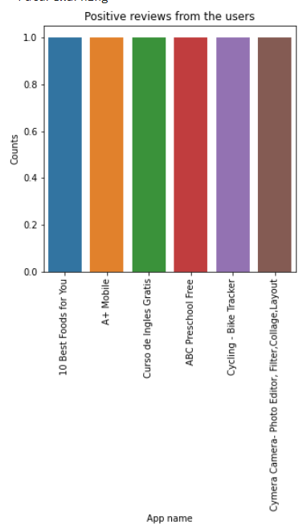
Sentimental Analysis
Based on user moods, the SA has three types such as Positive, Negative and Neutral.
For Positive moods we have about 20000+ translated reviews, for Negative we have 7000+ reviews and for neutral we have 5000+ reviews
Few of the Positive reviews are listed below

Slide 14
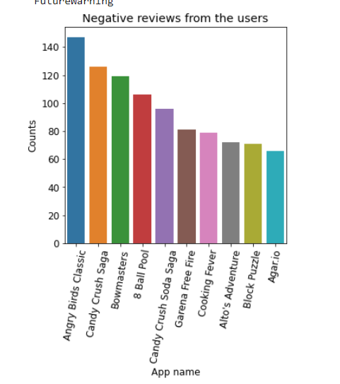
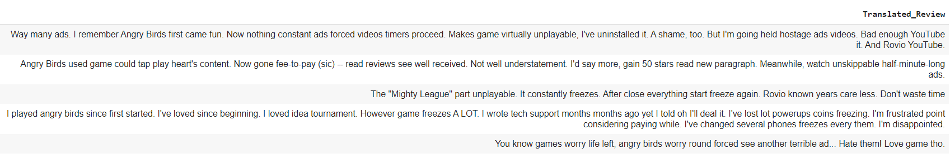
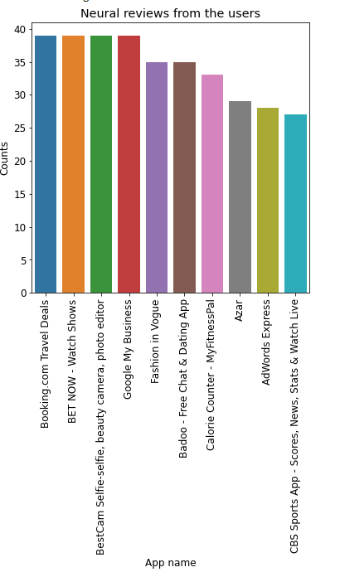
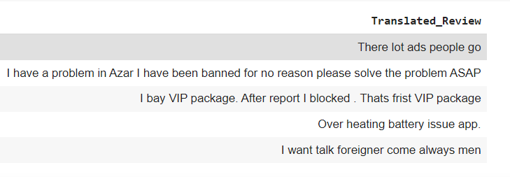
Negative and Neutral Sentimental Analysis
We have few Negative SA listed below
Below is the Neutral SA,

Slide 15
Conclusions
“SUBWAY SURFERS” is the most installed app in Google Play store with 6 Billion + installations, followed by “Google News”,” Hangouts “,” Google Drive”,” Google Photos” and ” Instagram are installed for 4 Billion + installations
When exploring the category in overall we have 33 categories and in that “FAMILY” has the most number of apps available and it alone accounts for 18.02% of apps in play store, followed by “GAME” category with 10.6%.
Users prefers to download FREE apps than PAID apps. Total FREE apps installed by users is 167.56 Billion+ installations and PAID apps is 72 Million+
In FREE apps, “GAME” category is most installed by the users and in PAID apps, “FAMILY” category is most installed.
The costliest PAID app is “I'm Rich - Trump Edition” which costs $400.00
Users tend to give Ratings in between 3 to 5. Most of the rated app lies in 4.4 stars.
The total reviews given by the users in Google play store altogether app combined is 4.81 Billion+ review. “FACEBOOK” is the most reviewed app with 78 Million+ reviews.
80.4% of ratings are provided by “EVERYONE” in content ratings.
Most of the apps supports Android version 4.1 and above.
When exploring “Genres”, “TOOLS” has the most number of apps available in play store followed by “ENTERTAINMENT” and “EDUCATION”

Slide 16
Conclusions (Cont)
Sentimental Analysis of the user is classified in three moods such as Positive, Negative and Neutral.
Users provided more Positive reviews than Negative
Positive reviews includes words such as “ works great”, “delicious” etc. denoting positive impact of the app
Negative reviews includes words such as “lots of ads”, ”terrible app” etc.

